Slide 1
R square and Adj R square

Slide 2



R square
R Squared is used to determine the strength of correlation between the features and the target.
It lets us know how good a regression model is when compared to the mean

Slide 3
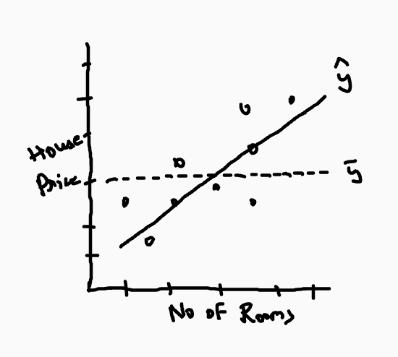
Example
We realise that our prediction line fits the data well . But we also need to find
How well does the model fit ?
Is it at least better than the mean ?

Slide 4
Example
Actual value (Y) | Predicted value (Y^) | Mean value (Y_bar) | Residual (y - y^) | Actual - mean
6100 | 7100 | 7705 | 1000 | 1605
9400 | 8500 | 7705 | 1100 | 1695
11000 | 11600 | 7705 | 600 | 3295
4320 | 5100 | 7705 | 780 | 3385
SSR = 1000*1000 + 1100*1100 + 600*600 + 780*780 = 3178400
SST = 1605*1605 + 1695*1695 + 3295*3295 + 3385*3385 = 27764300
R2 = 1-SSR/SST
=0.8855
.
Relationship between 'House price' and 'Number of rooms' explains 88.55% variation of the data

Slide 5
Analyzing R2
R2 will be 1, if SSR = 0 i.e.., Y = Y_hat , which means the predictions are exactly same as actual values ,
R2 will be 0 , if SSR = SST i.e.., y_hat = y_bar
R2 can also be negative , This happens when SSR > SST

Slide 6
Adjusted R squared
R square keeps increasing by adding more number of features , this property is called "R2 inflation" or "Increasing nature of R2" .
Adjusted R Squared has the capability to decrease with the addition of less significant variables, resulting in a more reliable and accurate evaluation.

Slide 7

Adjusted R squared Formula
K = number of Features [ Large K , Penalize metric]

